Slide 1


Longitudinal changes in teachers’ beliefs and behaviour when implementing reading innovations
Mareike Ehlertª, Fien De Smedt^{b}, Hilde Van Keer^{b}, Elmar Souvignierª
ª University of Münster, Germany, ^{b} Ghent University, Belgium

Slide 2


Implementing innovations
Teacher competencies
(Desimone, 2009; Slavin, 2020)
Evidence-based innovations
(Gheyssens et al., 2020)
School practice
(Peters et al., 2021; Slavin, 2020)
Notes:
While numerous evidence-based innovations exist, their regular implementation in school practice remains rare (Slavin, 2020). One reason for this hesitant adoption may be that such innovations require profound changes from teachers, which in turn is a lengthy process (Guskey, 1988). Typically, implementation entails a change of teachers’ professional competencies (Guskey, 1988; Rogers, 2003).

Slide 3
Teacher competencies for implementing innovations
Teacher beliefs
Acceptability: extent to which an intervention is perceived as satisfactory (Proctor et al., 2011)
Perceived feasibility: extent to which an intervention is considered feasible for daily practice (Proctor et al., 2011)
Self-efficacy: degree to which teachers believe their instruction positively influences student learning (Bandura, 1997)
Teacher behaviour
Implementation fidelity: extent to which teachers adhere to the innovation’s intended principles (O’Donnell, 2008)
Innovation use: extent to which teachers enact the innovation‘s practices (Petermann, 2014)
Adaptivity: extent to which teachers adapt their own instruction to their students’ individual needs (Connor, 2019)
Notes:
On the one hand, desired teacher change includes the development of favourable beliefs towards the innovation, such as acceptability and perceived feasibility (Petermann, 2014), as well as developing self-efficacy beliefs towards implementing the innovative approach (Bandura, 1997).
On the other hand, implementation processes require behavioural changes from teachers, as teachers must enact the innovation’s practices (Petermann, 2014), must adhere to the innovation’s intended principles (O’Donnell, 2008), and at the same time adapt their instruction to their students’ individual needs (Connor, 2019).

Slide 4
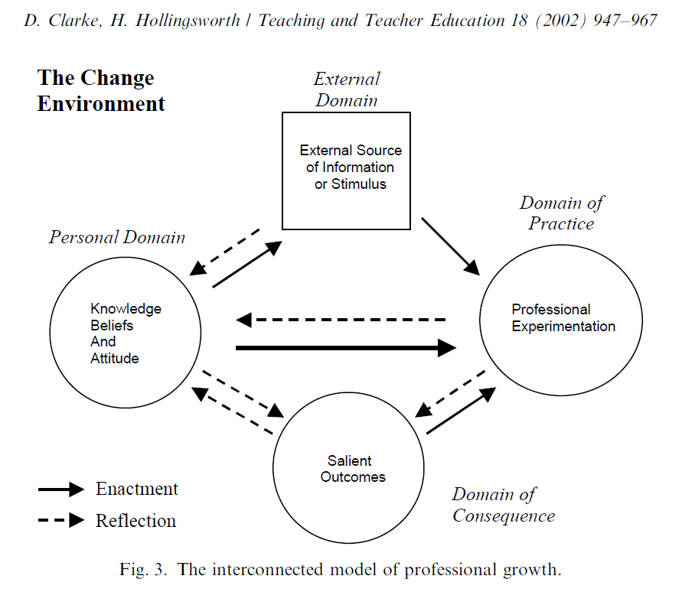
Longitudinal changes in teachers’ beliefs and behaviour
Teachers’ beliefs and behaviour are often investigated as either prerequisites for change processes (e.g., Künsting et al., 2016) or as outcomes to measure implementation success (Petermann, 2014)
However, theoretical models posit that they are subject to change over time (Clarke & Hollingsworth, 2002; Opfer & Pedder, 2011)
Notes:
In implementation studies, teachers’ beliefs and behaviour are often investigated as either prerequisites for change processes (e.g., Künsting et al., 2016) or as outcomes to measure implementation success (Petermann, 2014). However, theoretical models posit that teacher beliefs and behaviour are subject to temporal changes (Opfer & Pedder, 2011). To date, there are only few empirical investigations into the longitudinal changes in teachers’ beliefs and behaviour in implementation processes.

Slide 5
Longitudinal changes in teachers’ beliefs and behaviour
So far, there are only few longitudinal empirical studies
Initial findings by Timperley et al. (2003):
Teachers’ willingness to implement increased after professional development,
… but then declined as teachers had to independently implement changes in their teaching,
… and rose again after several months when teachers developed corresponding routines.
Notes:
Timperley and Phillips (2003) found that teachers’ motivation for implementation increased after participating in a PD programme but decreased when teachers had to make first instructional changes. As they became more confident, teachers’ motivation increased again. While Timperley and Phillips’s (2003) study serves as a good indicator for assuming that there are dynamic changes during implementation processes, the direction of these changes still requires evidence from further longitudinal studies.

Slide 6
Individual and contextual factors influencing teacher change
Individual factors
Teachers’ prior self-efficacy: linked to improved teaching quality and higher innovation use (Künsting et al., 2016; Orona et al., 2022)
Teachers’ prior knowledge: intervention effectiveness depends on teachers’ pre-existing subject knowledge (Santagata et al., 2010)
Contextual factors
Principal support: may support implementation of instructional methods (Grissom et al., 2021)
School transfer climate: may increase perception of time, financial and human resources for implementation (State et al., 2017)
Notes:
Changes in teachers’ beliefs and behaviour may further be influenced by a combination of their individual and contextual pre-conditions (Caddle et al., 2016). Among others, relevant individual conditions include teachers’ prior self-efficacy and prior knowledge of the subject matter. To illustrate, prior self-efficacious beliefs are associated with improved teaching quality (Künsting et al., 2016) and higher innovation use (Orona et al., 2022). For prior knowledge, Santagata et al. (2010) found that the effectiveness of their mathematics intervention depended on teachers’ content knowledge before PD. At the contextual level, a principal’s support and a school’s transfer climate are known to influence implementation outcomes (Ulla & Poom-Valickis, 2023). Principals who foster a learning culture and guide the implementation process contribute to successful change. Indeed, perceived principal support is associated with higher improvements in instructional methods and student academic progress (Grissom et al., 2021). Similarly, a school’s transfer climate facilitates implementation, encompassing the availability of time and financial resources to sustain and reinforce new practices (Aldridge & Fraser, 2016; MacNeil et al., 2009). Teachers’ acceptability and feasibility ratings are, for instance, associated with the time, financial and human resources provided by the school (State et al., 2017).

Slide 7

Research Questions
Do teachers’ beliefs (acceptability, feasibility, self-efficacy) and behaviour (innovation use, fidelity, adaptivity) change longitudinally during the implementation process?
Following Timperley & Phillips (2003), significant changes in the variables mentioned are assumed. The directions of these changes will be investigated exploratively.
Can distinct clusters be identified based on teachers’ individual pre-conditions (self-efficacy, knowledge) and contextual pre-conditions (principal support, transfer climate)?
What are longitudinal trends in teachers’ beliefs and behaviour depending on the cluster?
Notes:
As there have been only few empirical studies which have examined the longitudinal process of teacher beliefs and behaviour during implementation processes, this study’s first aim is to investigate the changes in these variables.
A second aim was to explore whether the interplay of contextual and individual pre-conditions can describe patterns of teacher change.

Slide 8
Method
Sample:
N = 47 primary school teachers from 20 schools
Predominantly female (95%)
Average age: 41.46 years (SD = 9.61)
Average teaching experience: 13.83 years (SD = 9.49)

Slide 9
Method
Design:
PD programme for multipliers
PD programme for teachers provided by trained multipliers
Supported implementation
Provision of printed teaching materials
Four exchange meetings with multipliers
Self-organised implementation
Provision of digital teaching materials
First school year
Second school year
Notes:
10 teacher educators were first trained as multipliers by the first and last author over a period of half a school year. In the following half year, these multipliers then trained the above-mentioned primary school teachers for implementing the reading innovation via the same PD programme (Figure 1). Over the course of the following school year, these teachers then implemented the reading innovation into their classroom. For the first six implementation months, teachers were supported in implementing the reading innovation by receiving (a) prepared teaching materials, and (b) support from the multipliers (e.g., through individual exchange meetings via telephone, e-mail). In the next three months, teachers had to self-organise their implementation and were only provided with digital teaching materials

Slide 10
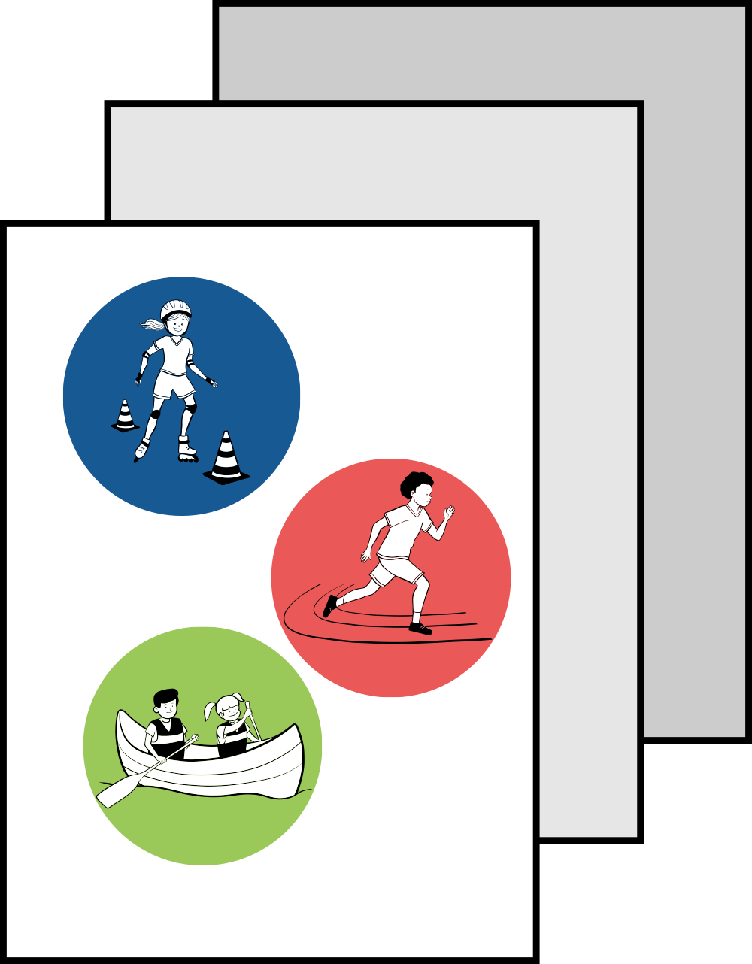

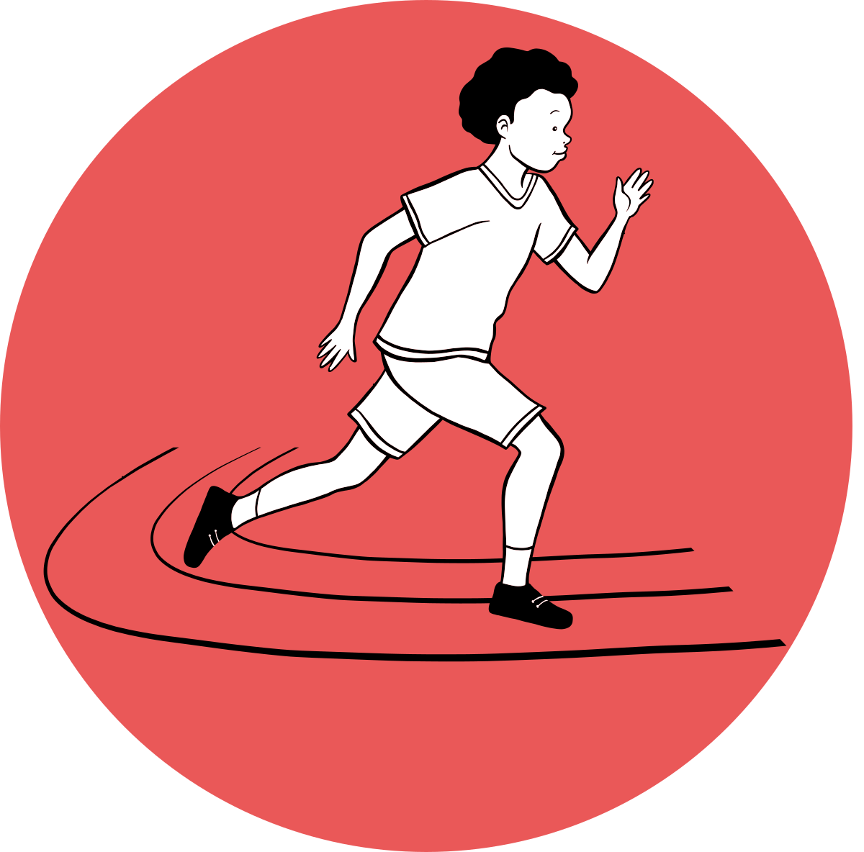
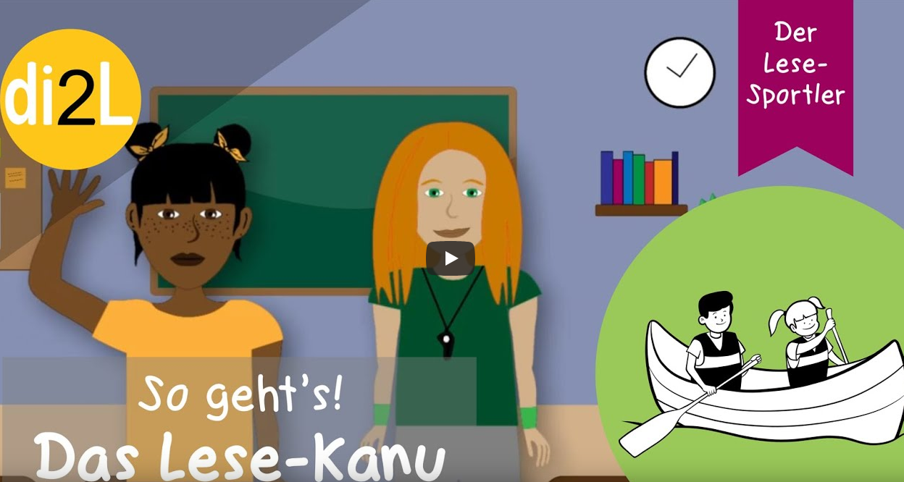

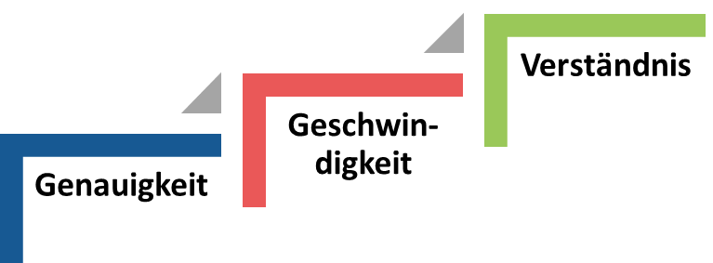
Method
The Reading Athlete (Hebbecker et al., 2020):
Prepared student booklets for three central subprocesses of reading – word accuracy, reading fluency and reading comprehension
Explanatory videos for students
Recommended use: Three times per week for 20 minutes
Notes:
The object of implementation was a differentiated reading intervention called The Reading Athlete. The Reading Athlete is an evidence-based reading programme for primary school students (Authors, 2020b). It provides teachers with student booklets for three central subprocesses of reading – word accuracy, reading fluency and reading comprehension (Castles et al., 2018). The programme thereby follows the approach of adaptive, differentiated reading instruction: Depending on a student’s reading performance, teachers select the most suitable reading method from The Reading Athlete. Adaptivity is thus required from teachers to navigate between three reading methods called The Reading Slalom, The Reading Sprint and The Reading Canoe.

Slide 11
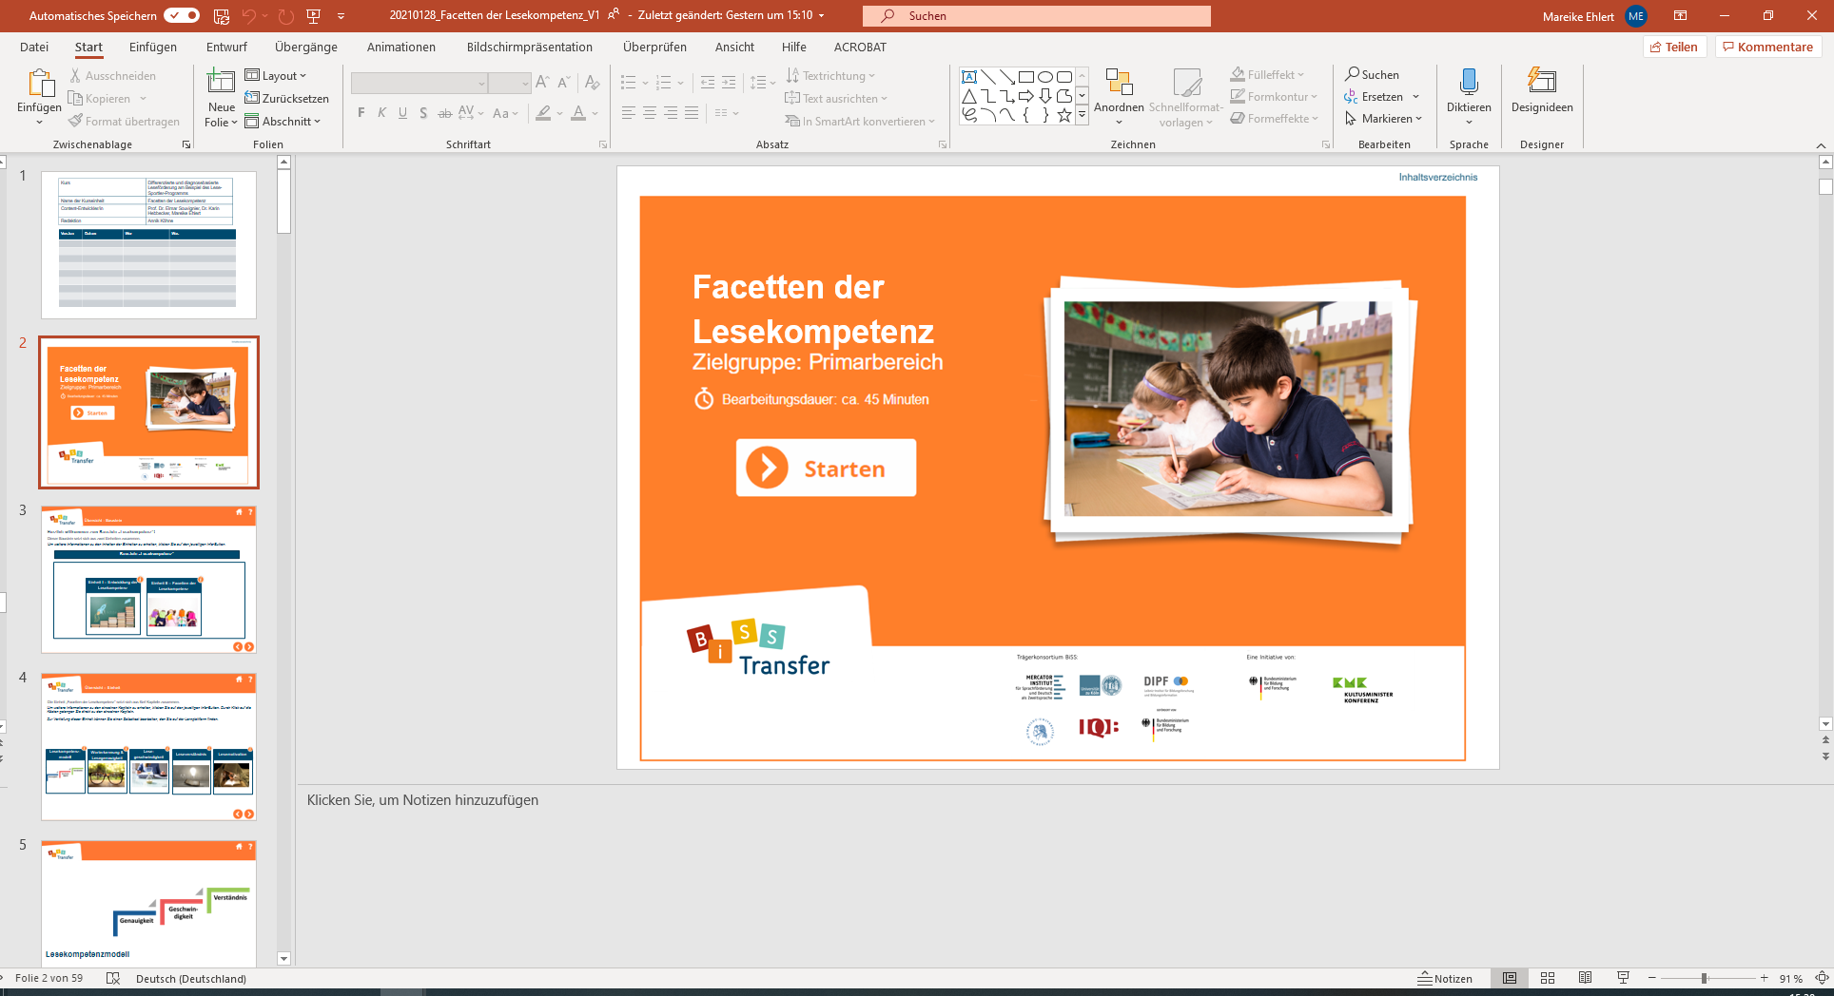
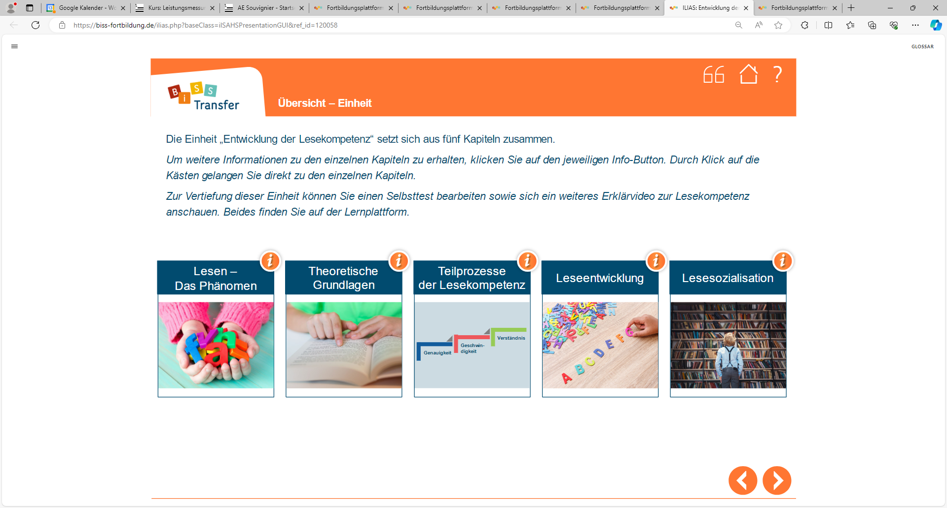
Method
PD programme:
7 e-learning-units à 45 minutes
3 full-day online face-to-face events
Completion of portfolio exercises
Support and individual exchange meetings with multipliers
www.biss-fortbildung.de

Slide 12
Method
Measures:
PD programme for multipliers
PD programme for teachers provided by trained multipliers
Supported implementation
Self-organised implementation
T1 before PD
Individual and contextual pre-conditions
T2
directly after PD programme
Teacher beliefs
T3
after 3 months of implementation
Teacher beliefs and behaviour
T4
after 6 months of implementation
Teacher beliefs and behaviour
T5
after 10 months of implementation
Teacher beliefs and behaviour

Slide 13
Method
Measures:
 | Item example | Cronbachs Alpha
TEACHER BELIEFS
Acceptability (Meudt et al., 2020) | I like the approach of the Reading Athlete. | [.71;.86]
Feasibility (Meudt et al., 2020) | I find the effort associated with the Reading Athlete reasonable. | [.87;.91]
Self-efficacy (Schmitz & Schwarzer, 2000) | I trust myself to be able to inspire all students to read. | [.74;.88]
TEACHER BEHAVIOUR
Implementation fidelity (Meudt et al., 2020) | When using the Reading Athlete, I follow the instructions from the blended learning units and the teacher manual as precisely as possible. | [.84;.88]
Innovation use (self-developed) | How often per week did you use the Reading Athlete? How many minutes did a session usually last? | -
Adaptivity (self-developed) | For what percentage of your pupils have you changed the Reading Athlete method? | -

Slide 14
Method
Measures:
 | Item example | Cronbachs Alpha
INDIVIDUAL PRE-CONDITIONS
Self-efficacy (Schmitz & Schwarzer, 2000) | I trust myself to be able to inspire all students to read. | .81
Knowledge (self-developed) | I know evidence-based methods that specifically promote reading fluency. | .85
CONTEXTUAL PRE-CONDITIONS
Principal support (Schulinspektion Hamburg, 2017) | The principal gives us suggestions on how we can improve our teaching. | .82
Transfer climate (Klein-Heßling & Drössler, 2007) | My workload allows me to try out new methods in the classroom. | .80

Slide 15
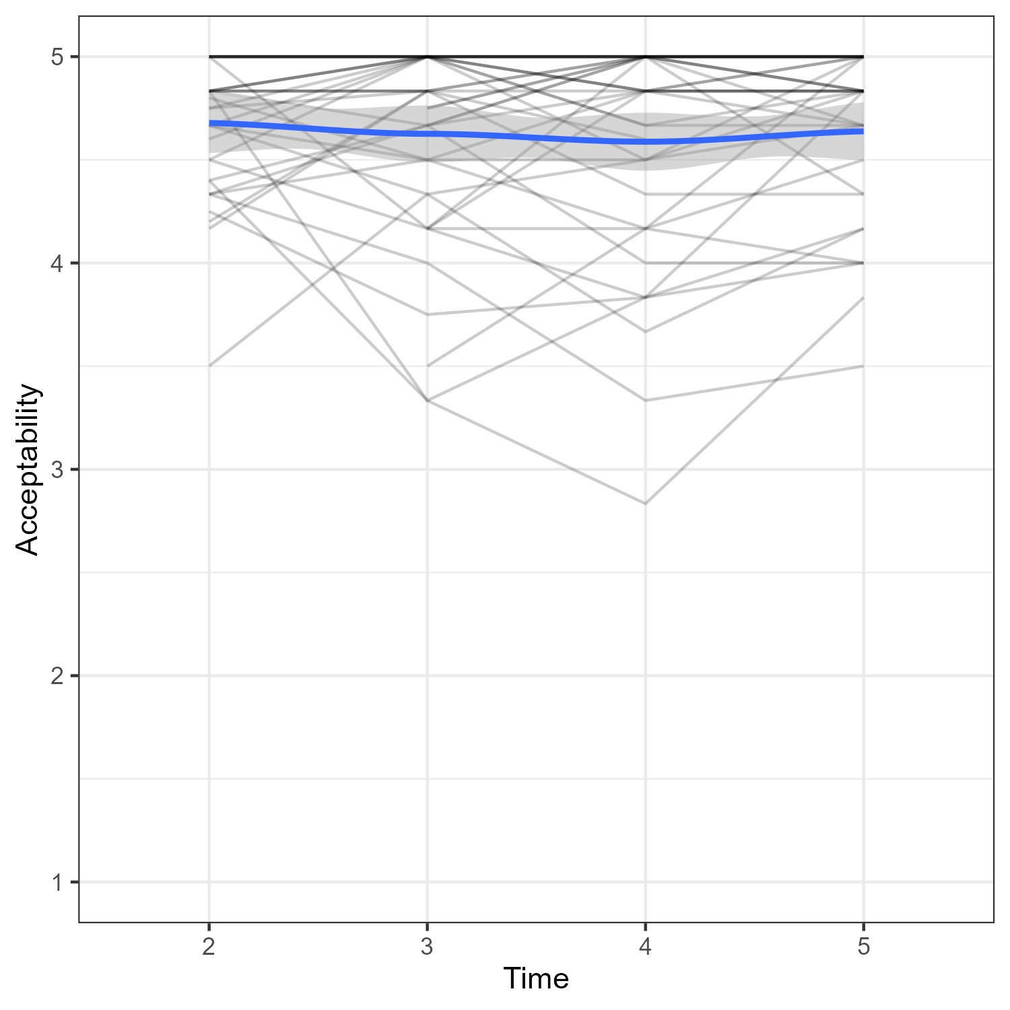
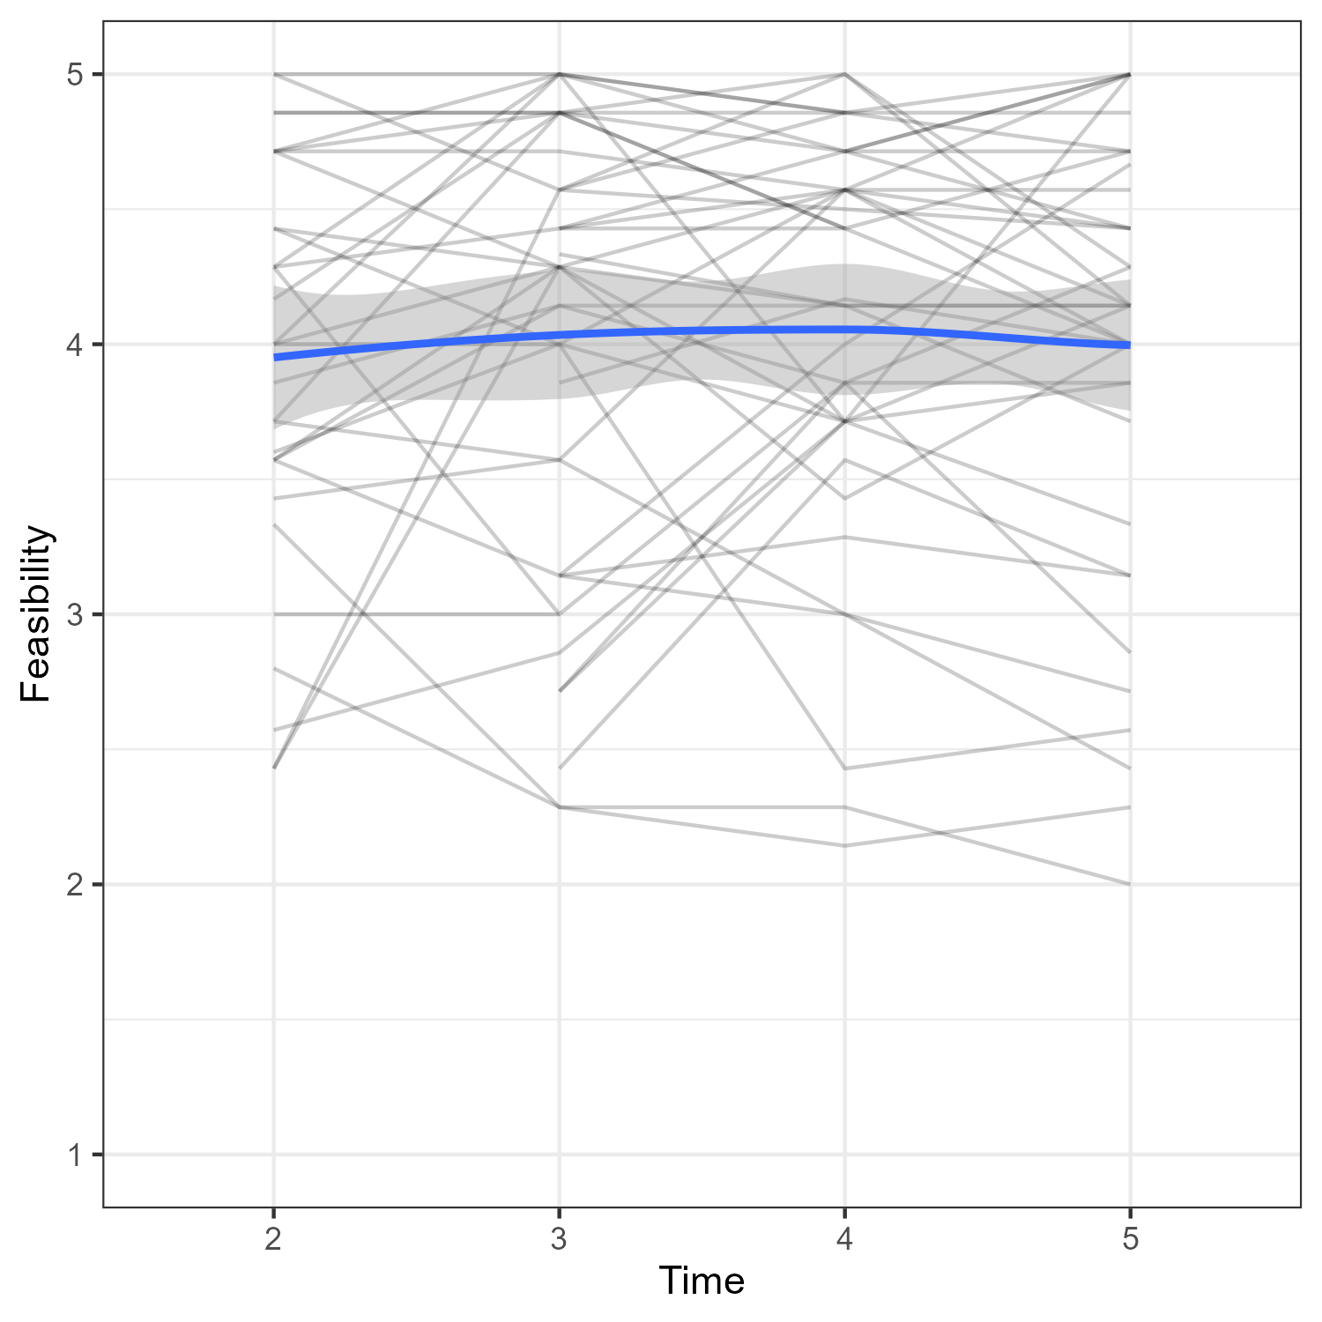
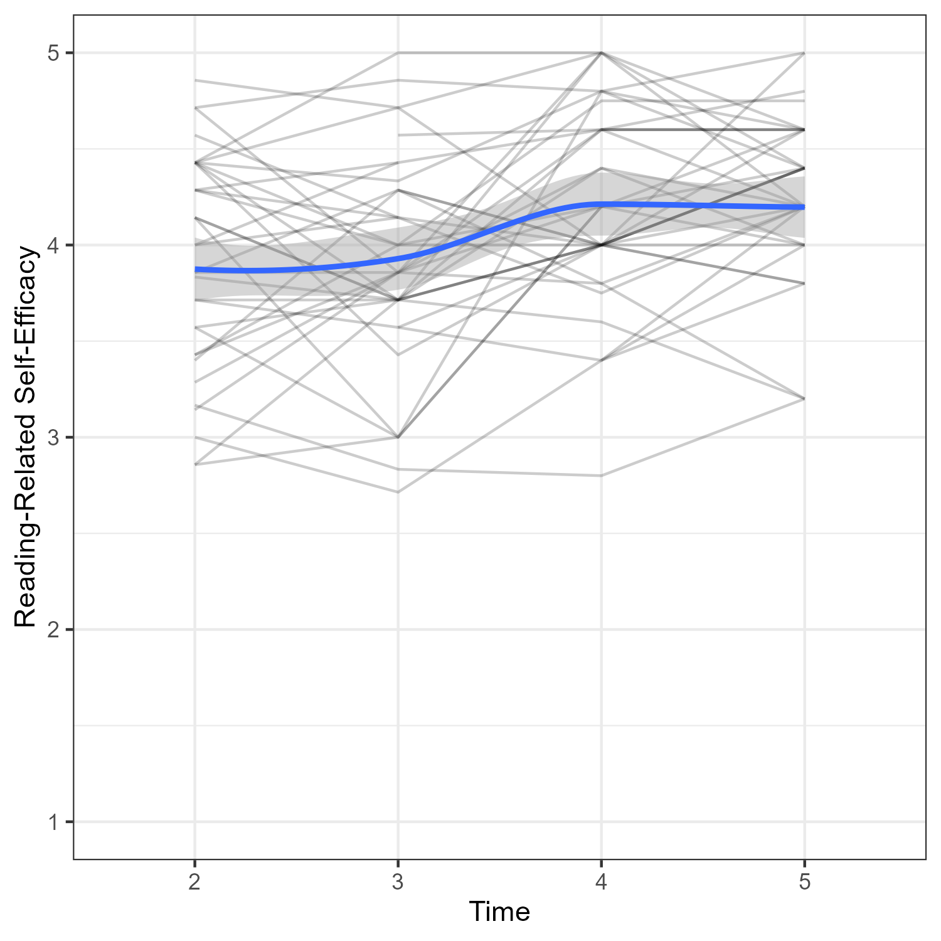
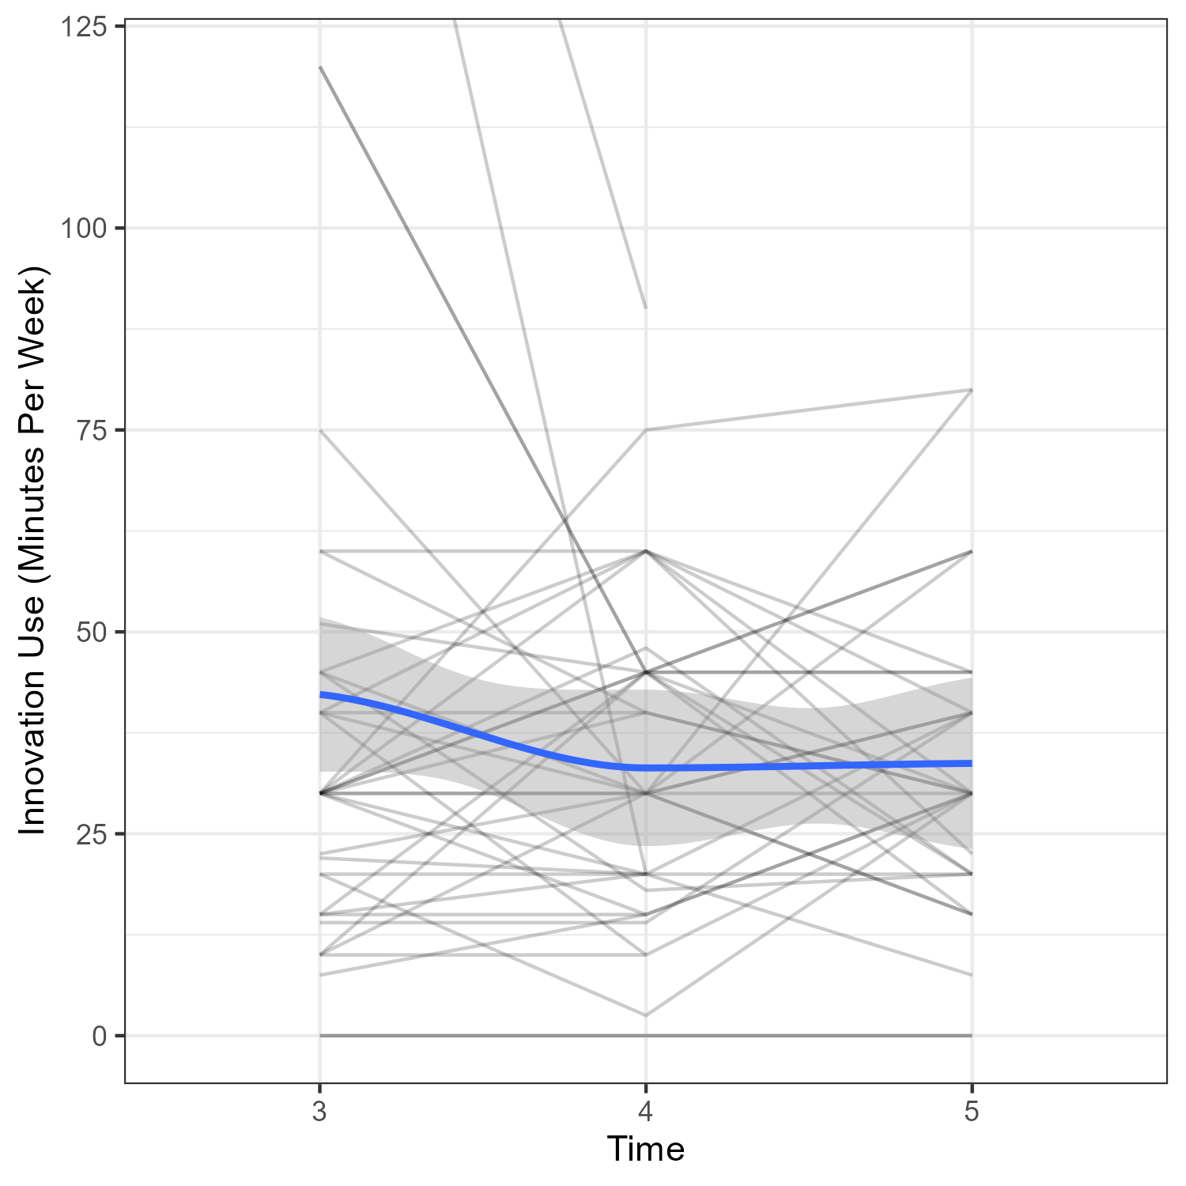
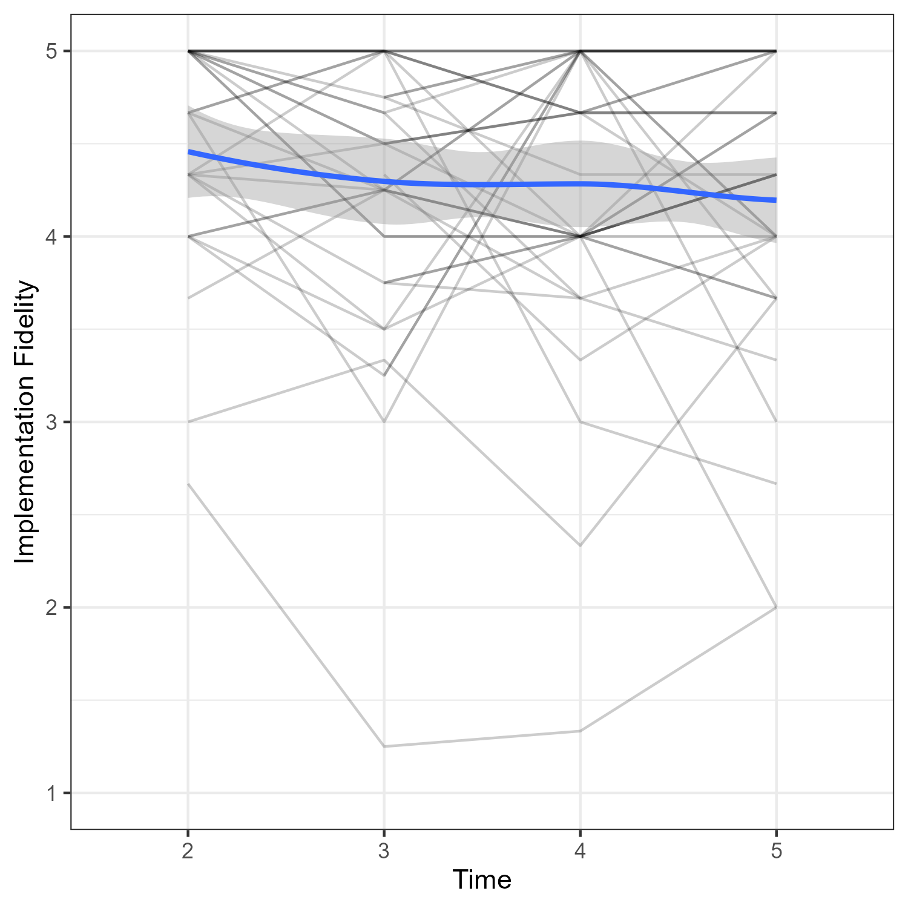
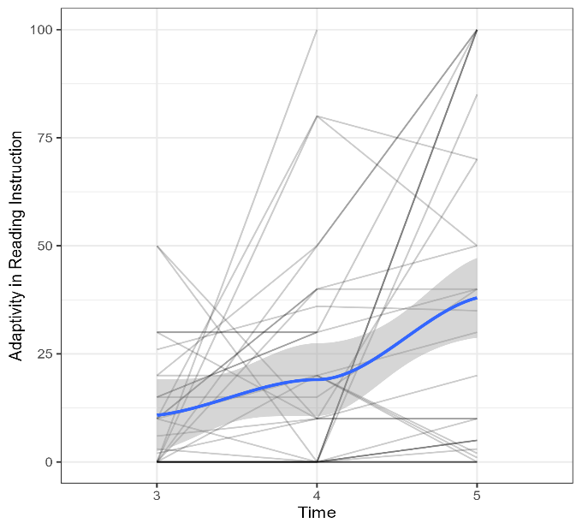
Results
Do teachers’ beliefs (acceptability, feasibility, self-efficacy) and behaviour (innovation use, fidelity, adaptivity) change longitudinally during the implementation process?
linear mixed effects models with time of measurement as predictor

Slide 16
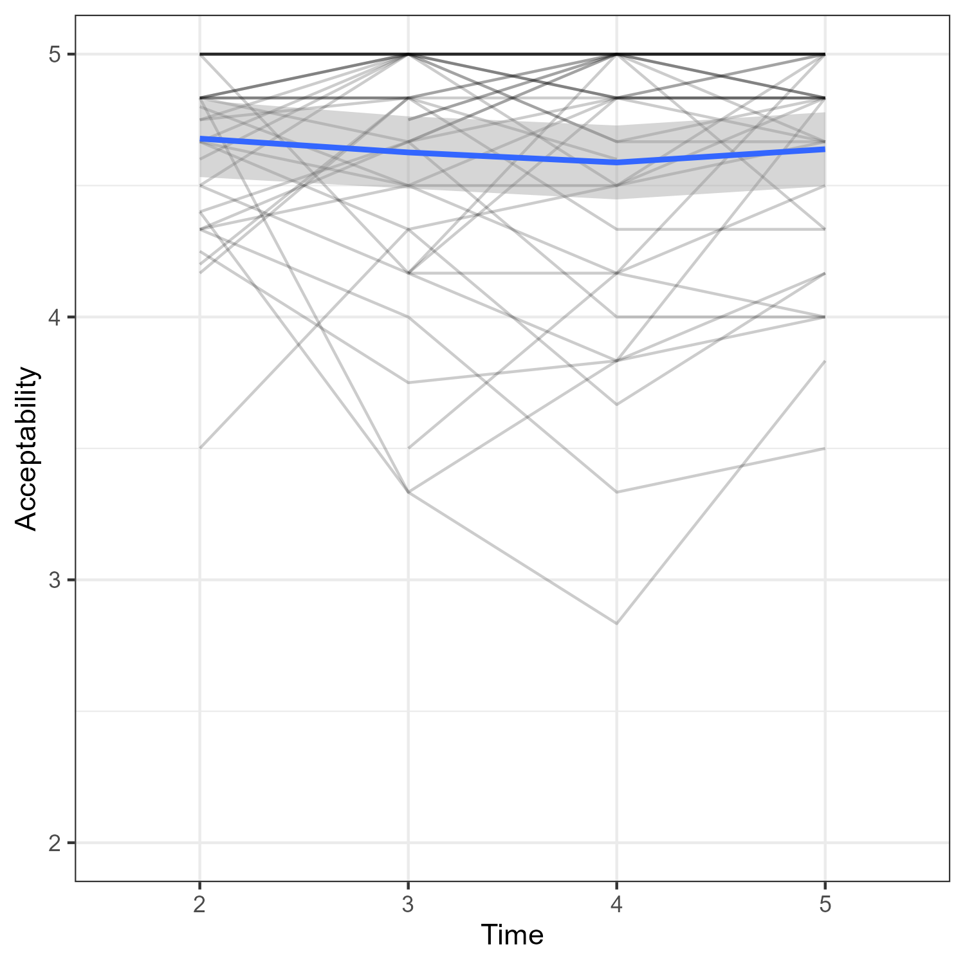
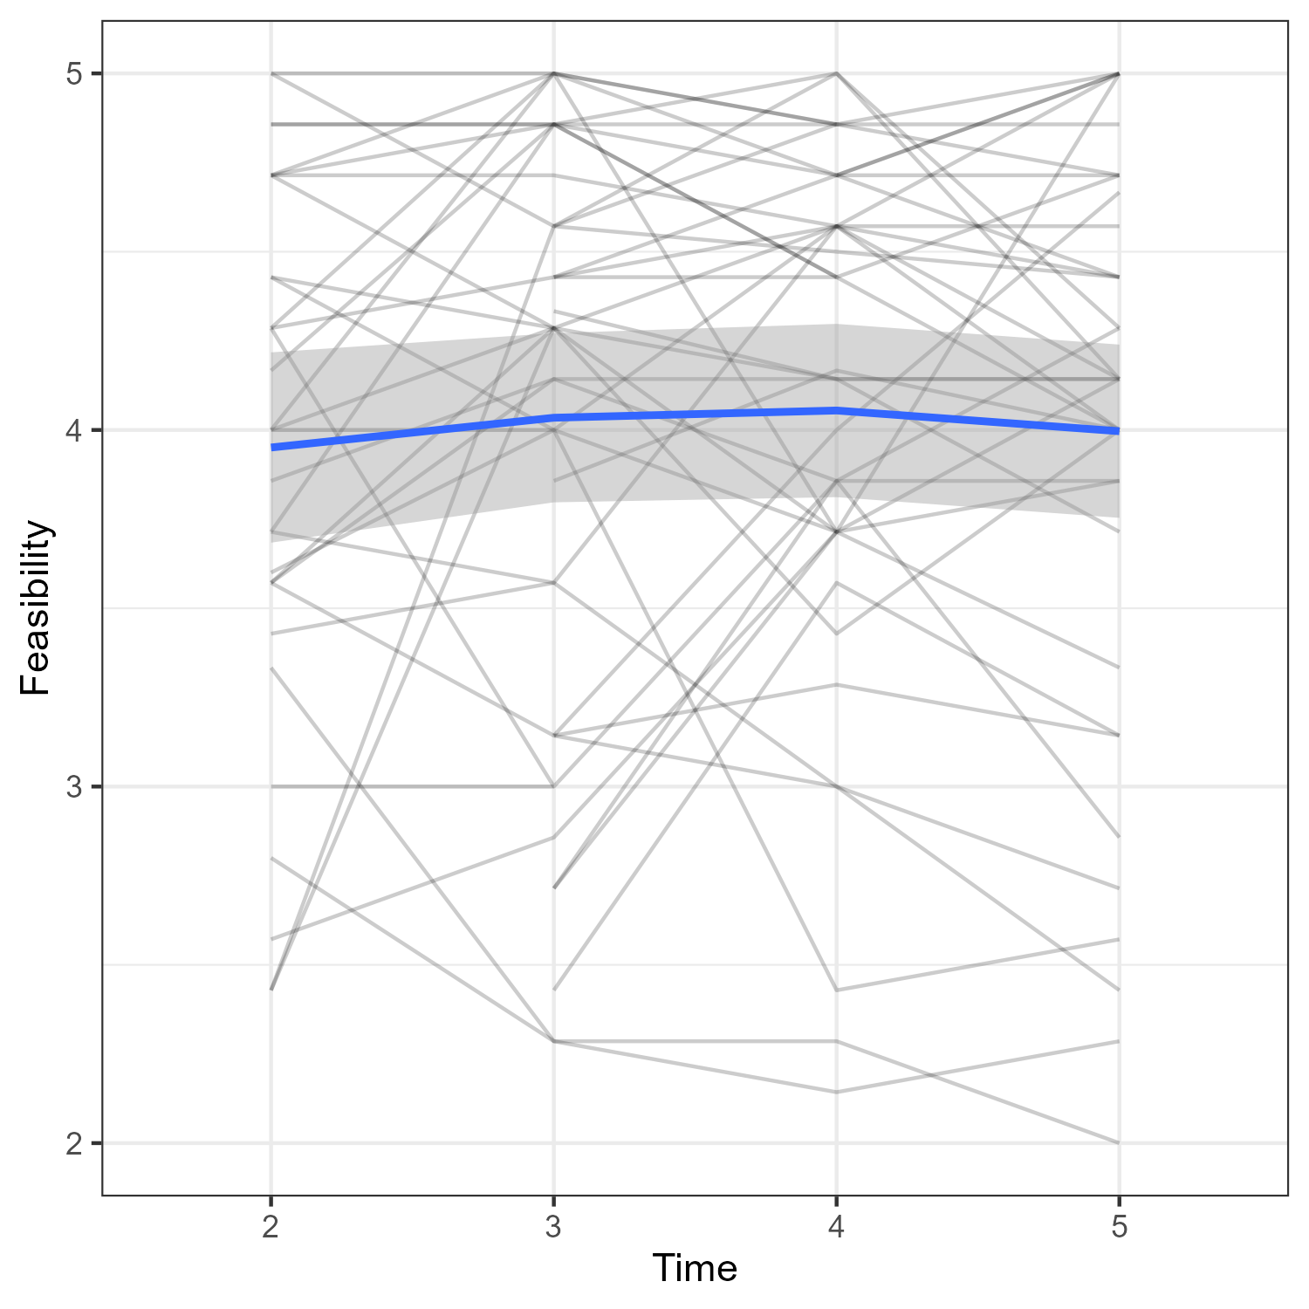
Results
Do teachers’ beliefs (acceptability, feasibility, self-efficacy) and behaviour (innovation use, fidelity, adaptivity) change longitudinally during the implementation process?
Teachers’ acceptability and perceived feasibility of the reading intervention stays consistently high over time (ß = -.059, p = 0.7; ß = .134, p = 0.362)

Slide 17
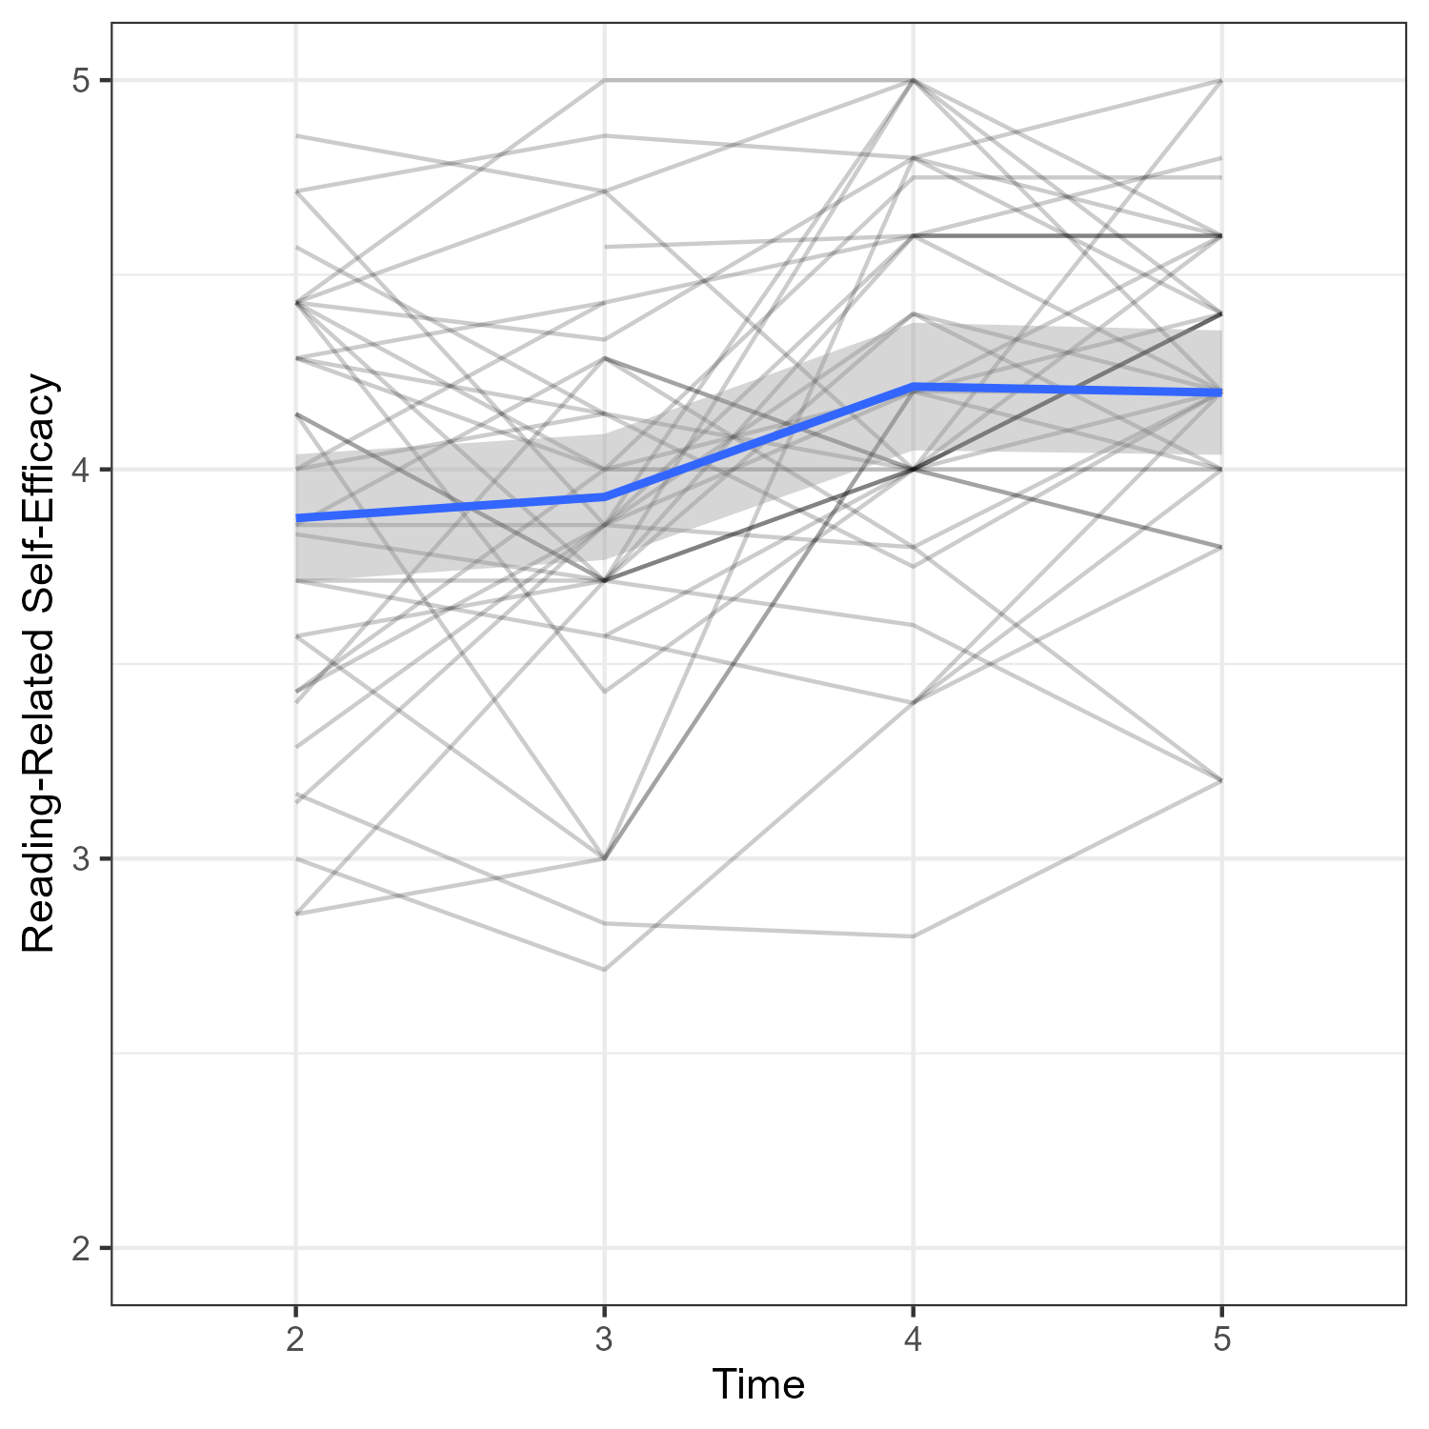
Results
Do teachers’ beliefs (acceptability, feasibility, self-efficacy) and behaviour (innovation use, fidelity, adaptivity) change longitudinally during the implementation process?
Teachers’ self-efficacy starts at a moderate level and increases significantly by the end of the school year (ß = .557, p = .001)

Slide 18
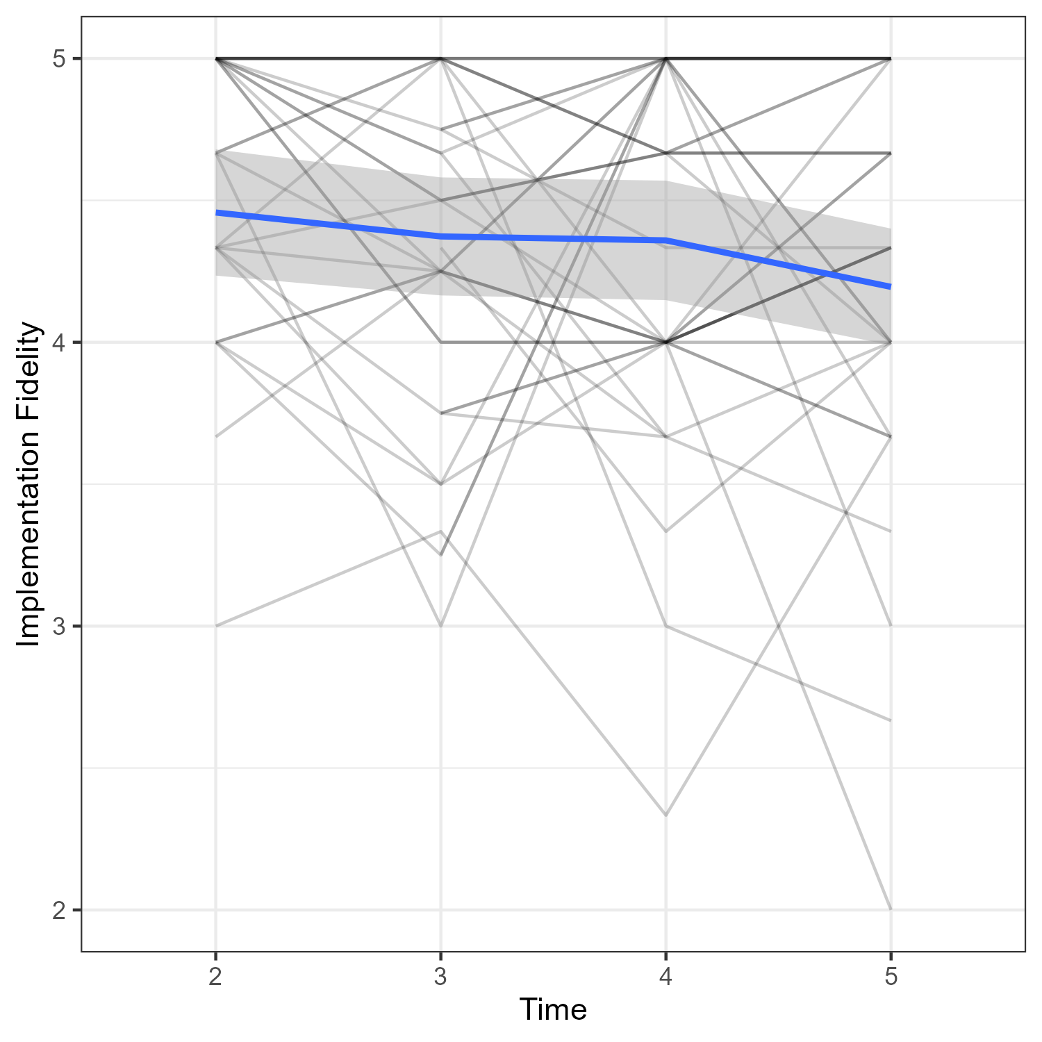

Results
Do teachers’ beliefs (acceptability, feasibility, self-efficacy) and behaviour (innovation use, fidelity, adaptivity) change longitudinally during the implementation process?
Teachers’ implementation fidelity and innovation use decrease during practical implementation (ß = -.349, p = .034; ß = -.273, p < .001)

Slide 19
Results
Do teachers’ beliefs (acceptability, feasibility, self-efficacy) and behaviour (innovation use, fidelity, adaptivity) change longitudinally during the implementation process?
Teachers’ adaptivity in reading instruction increases over the course of the entire school year (ß_{log} = -.584, p = .027)

Slide 20
Results
Can distinct clusters be identified based on teachers’ individual pre-conditions (self-efficacy, knowledge) and contextual pre-conditions (principal support, transfer climate)?
Cluster analyses based on Fuzzy C-Means
Cluster 1
Cluster 2

Slide 21
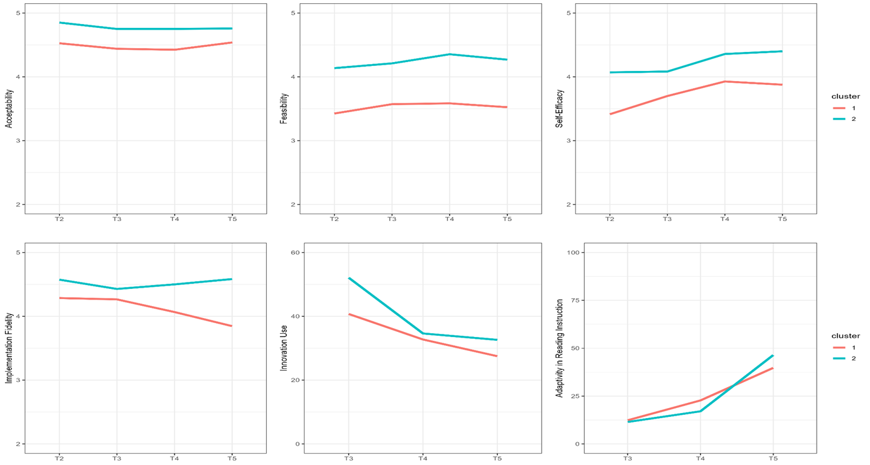
Results
What are longitudinal trends in teachers’ beliefs and behaviour depending on the cluster?
Beliefs show similar developments for both clusters, but with level differences.
Teachers with moderate pre-conditions display a steeper decline in fidelity.

Slide 22
Discussion
Beliefs: Mostly stable, with self-efficacy increasing
likely driven by strong PD support and experiences of mastery
Behaviour: Rising adaptivity alongside declining fidelity and use
teachers might benefit from reminders about recommended innovation use
decreasing fidelity along rising adaptivity may reflect teachers adapting the innovation to their context
Individual and contextual conditions matter:
although trends were similar, clear level differences emerged
teachers with moderate support showed steeper decline in fidelity
importance of differentiated PD support

Slide 23
Limitations and implications
Small sample size due to longitudinal intervention prevented analysis of reciprocal effects between beliefs & behaviour
Data relied solely on self-reports; including classroom observations would have strengthened insights into behavioural variables
Cluster analysis lacked teachers with suboptimal pre-conditions (voluntary participation bias)
In sum, our study emphasises…
need for continuous, differentiated PD support, especially for teachers with moderate pre-conditions
opportunities for incorporating ongoing reinforcement for behavioural dimensions
that teacher change is a gradual, long-term process

Slide 24
Thank you! Contact: mareike.ehlert@uni-muenster.de

Slide 25
References
Bandura, A. (1997). Self-efficacy: The exercise of control. W H Freeman/Times Books/ Henry Holt & Co.
Clarke, D., & Hollingsworth, H. (2002). Elaborating a model of teacher professional growth. Teaching and teacher education, 18(8), 947-967. https://doi.org/10.1016/S0742-051X(02)00053-7
Connor, C. M. (2019). Using technology and assessment to personalize instruction: Preventing reading problems. Prevention Science: The Official Journal of the Society for Prevention Research, 20(1), 299–322. https://doi.org/10.1007/s11121-017-0842-9
Desimone, L. M. (2009). Improving impact studies of teachers’ professional development: Toward better conceptualizations and measures. Educational Researcher, 38(3), 181–199. https://doi.org/10.3102/0013189X08331140
Gheyssens, E., Consuegra, E., Engels, N., & Struyven, K. (2020, June). Good things come to those who wait: The importance of professional development for the implementation of differentiated instruction. In Frontiers in Education (Vol. 5, p. 96). Frontiers Media SA. https://doi.org/10.3389/feduc.2020.00096
Grissom, J. A., Egalite, A. J., & Lindsay, C. A. (2021). How principals affect students and schools: a systematic synthesis of two decades of research. https://www.wallacefoundation.org/knowledge-center/pages/how-principals-affect- students-and-schools-a-systematic-synthesis-of-two-decades-of-research.aspx
Hebbecker, K., Meudt, S.‑I., Schütze, B., & Souvignier, E. (2020). Der Transfer von formativem Assessment in den Leseunterricht der Grundschule. Zeitschrift für Pädagogische Psychologie, 1–15. https://doi.org/10.1024/1010-0652/a000279
Henninger, K. (2010). Exploring the Relationship Between Factors of Implementation, Treatment Integrity and Reading Fluency. [Dissertation].
Klein-Heßling, J., & Drössler, S. (2007). Transferklima [Transfer climate]. In M. Jerusalem, S. Drössler, D. Kleine, J. Klein-Heßling, W. Mittag, & B. Röder (Eds.), Förderung von Selbstwirksamkeit und Selbstbestimmung im Unterricht, Skalen zur Erfassung von Lehrer- und Schülermerkmalen (pp. 114–116).

Slide 26
References
Künsting, J., Neuber, V., & Lipowsky, F. (2016). Teacher self-efficacy as a long-term predictor of instructional quality in the classroom. European Journal of Psychology of Education, 31(3), 299–322. https://doi.org/10.1007/s10212-015-0272-7
Meudt, S. I., Zeuch, N., Neuber, L., & Souvignier, E. (2020). Kurzskalen zur Erfassung des Transfererfolgs von Leseförderkonzepten in der Schulpraxis [Short scales for assessing the transfer success of reading interventions in school practice]. In Forschungsinstrumente im Kontext institutioneller (schrift-)sprachlicher Bildung [Research tools in the context of institutional (written) language education] (pp. 141-157).
O’Donnell, C. L. (2008). Defining, conceptualizing and measuring fidelity of implementation and Its relationship to outcomes in k–12 curriculum intervention research. Review of Educational Research, 78(1), 33–84. https://doi.org/10.3102/0034654307313793
Opfer, V. D., & Pedder, D. (2011). Conceptualizing teacher professional learning. Review of educational research, 81(3), 376-407. https://doi.org/10.3102/0034654311413609
Orona, G. A., Li, Q., McPartlan, P., Bartek, C., & Xu, Di. (2022). What predicts the use of interaction-oriented pedagogies? The role of self-efficacy, motivation, and employment stability. Computers & Education, 184, 1–24. https://doi.org/10.1016/j.compedu.2022.104498
Petermann, F. (2014). Implementationsforschung: Grundbegriffe und Konzepte. Psychologische Rundschau, 65(3), 122–128. https://doi.org/10.1026/0033-3042/a000214
Peters, S. J., Matthews, M. S., McBee, M. T., & McCoach, D. B. (2021). Beyond gifted education: Designing and implementing advanced academic programs. Routledge https://doi.org/10.4324/9781003233299
Proctor, E., Silmere, H., Raghavan, R., Hovmand, P., Aarons, G., Bunger, A., ... & Hensley, M. (2011). Outcomes for implementation research: conceptual distinctions, measurement challenges, and research agenda. Administration and Policy in Mental Health and Mental Health Services Research, 38(2), 65-76. https://doi.org/10.1007/s10488-010-0319-7

Slide 27
References
Santagata, R., Kersting, N., Givvin, K. B., & Stigler, J. W. (2010). Problem implementation as a lever for change: An experimental study of the effects of a professional development program on students’ mathematics learning. Journal of Research on Educational Effectiveness, 4(1), 1–24. https://doi.org/10.1080/19345747.2010.498562
Schmitz, G. S., & Schwarzer, R. (2000). Selbstwirksamkeitserwartung von Lehrern: Längsschnittbefunde mit einem neuen Instrument [Teachers’ self-efficacy: Longitudinal findings with a new instrument]. Zeitschrift Für Pädagogische Psychologie, 14(1), 12–25. https://doi.org/10.1024//1010-0652.14.1.12
Schulinspektion Hamburg. (2017). Instruktionale Führung [Instructional leadership]. In Skalenhandbuch der Schulinspektion Hamburg [Scale manual of the Hamburg School Inspection].
Slavin, R. E. (2020). How evidence-based reform will transform research and practice in education. Educational Psychologist, 55(1), 21-31. https://doi.org/10.1080/00461520.2019.1611432
State, T. M., Harrison, J. R., Kern, L., & Lewis, T. J. (2017). Feasibility and acceptability of classroom-based interventions for students with emotional/behavioral challenges at the high school level. Journal of Positive Behavior Interventions, 19(1), 26–36. https://doi.org/10.1177/1098300716648459
Timperley, H. S., & Phillips, G. (2003). Changing and sustaining teachers’ expectations through professional development in literacy. Teaching and Teacher Education, 19(6), 627-641. https://doi.org/10.1016/S0742-051X(03)00058-1

